Slide 1

DSC 650 – Big Data
Week 10 Assignment - Big Data Architecture
Presented by Eyram Kueviakoe

Slide 2

Agenda
Problem Statement
Proposed Architecture
Data flow and real-time analysis
Data storage, retrieval, and advanced analysis
Benefits and Conclusion

Slide 3

Problem Statement
Problem statement
What is fraudulent activity?
What is fraud detection?

Slide 4

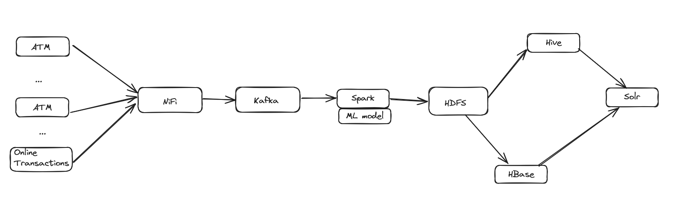
Architecture

Slide 5
Role of each tool
Nifi: Data ingestion, routing, and transformation tool.
Kafka: Real-time data streaming platform
Spark: Real-time data processing and analytics
HDFS: Storage of vast amounts of transactional data.
Hive:Data warehousing and querying large datasets stored in HDFS.
Hbase: NoSQL database for real-time read/write access to large datasets.
Solr:Search platform for indexing and querying data and monitoring

Slide 6
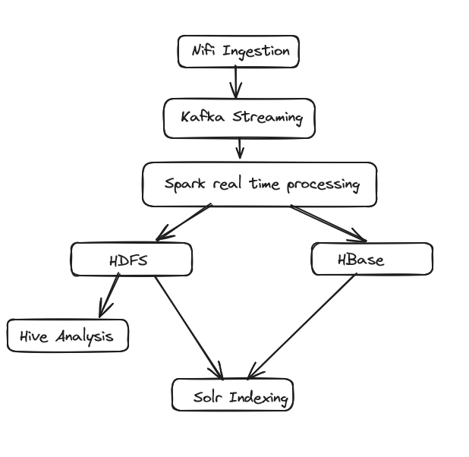
Data Flow and real time analysis

Slide 7
Importance of HDFS, Hive, Hbase and Solr
Hive:
Query and analyze data
Data warehousing
Tools integration
HBase
Real time data access
Scalability
Low latency
Solr:
Real time search and indexing
Monitoring
Query performance
HDFS:
Store large volume of data
Batch processing
Data replication

Slide 8
Advantages of the proposed solution
Reduce fraud risk
Efficient data handling
Quick access to transaction records
The bank will enhance customer trust
Meet compliance and banking regulations

Slide 9
Thank You

